Slide 1
Photomicrographs of Plant foods
Rhubarb
Permission to reproduce original photomicrographs used to make this collection may be obtained from
Dr. David O. Norris at
david.norris@colorado.edu

Slide 2
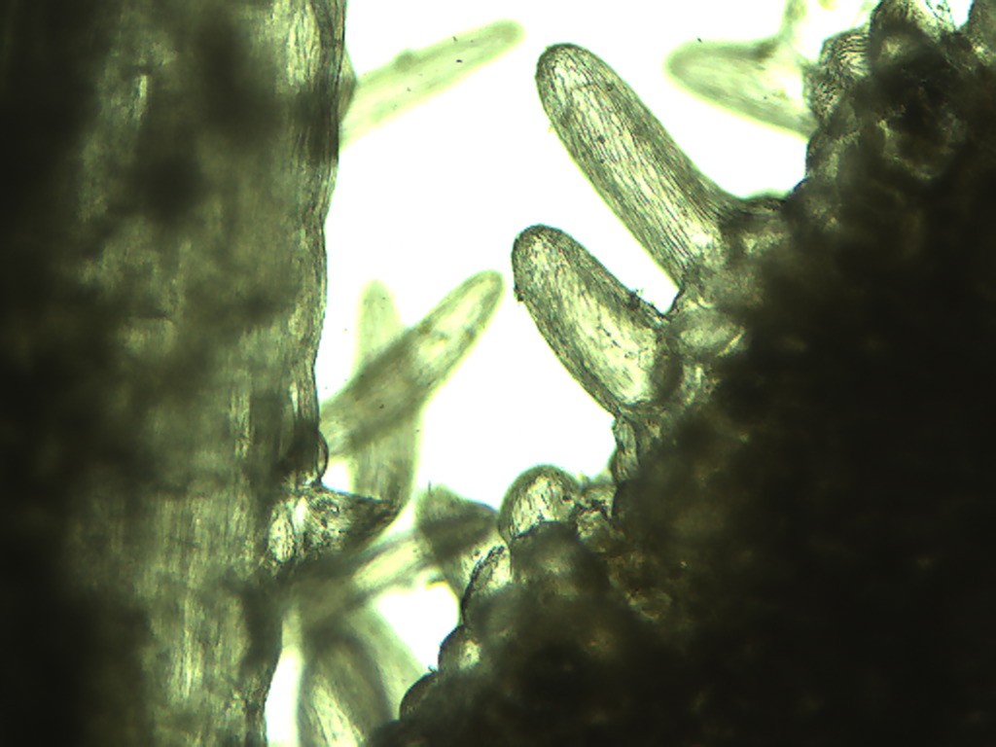
Notes:
430. Rheum x cultorum = Rheum rharbararum Rhubarb leaf. Very large epidermal trichomes, 10X. Leaves are not eaten.

Slide 3
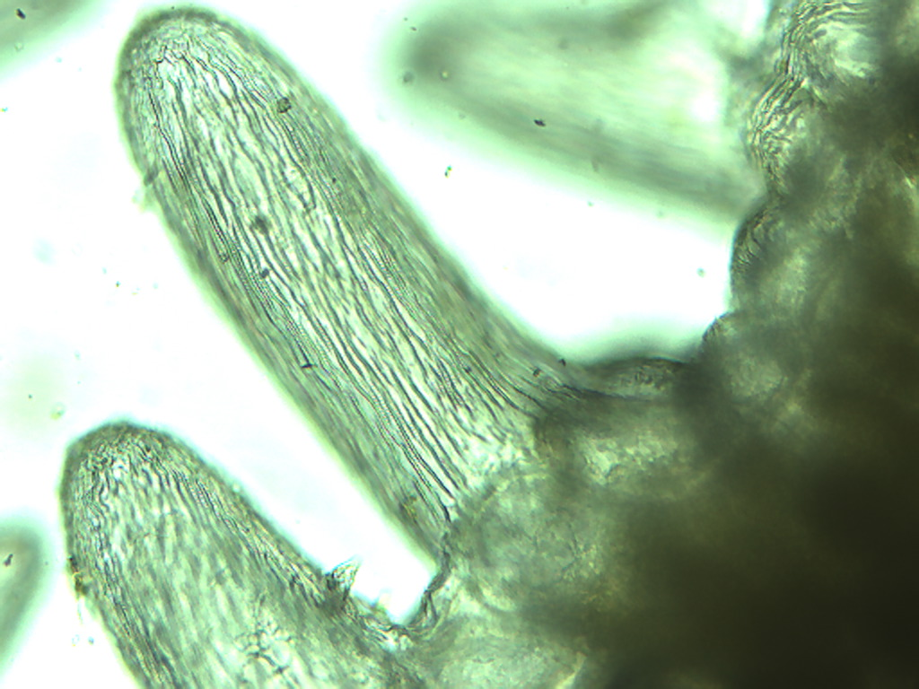
Notes:
431. Rhubarb leaf. Epidermal trichomes, 25X.

Slide 4
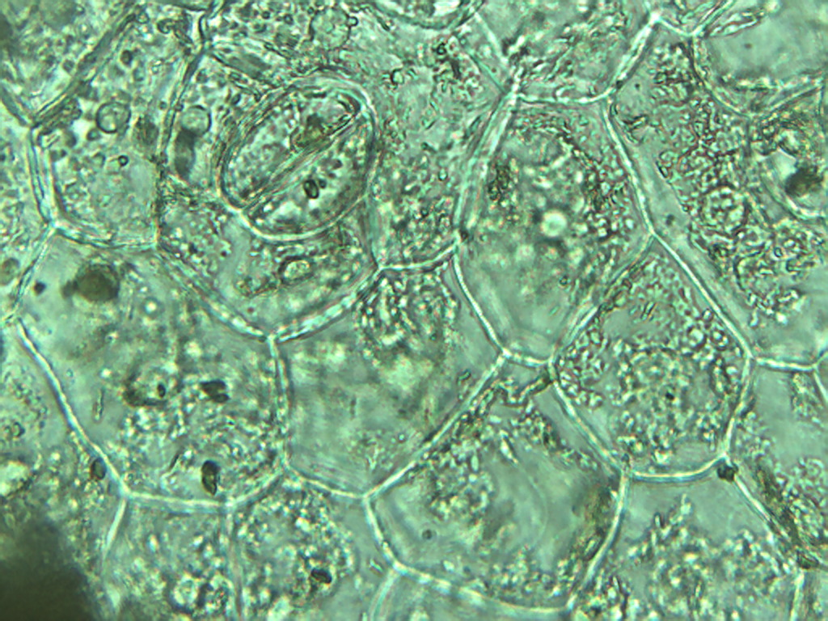
Notes:
432. Rhubarb leaf. Epidermal cells and stomate (arrow), 40X.

Slide 5
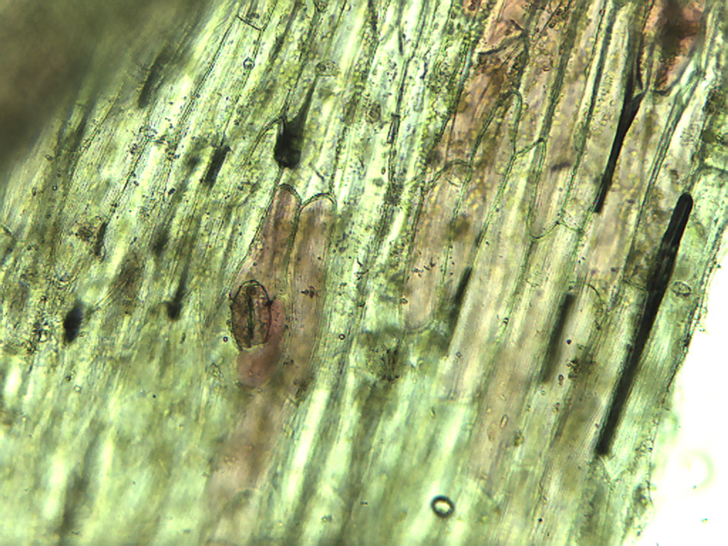
Notes:
433. Rhubarb; Elongate epidermal cells (some containing red pigment) and stomate (arrow) in petiole skin, 10X.

Slide 6
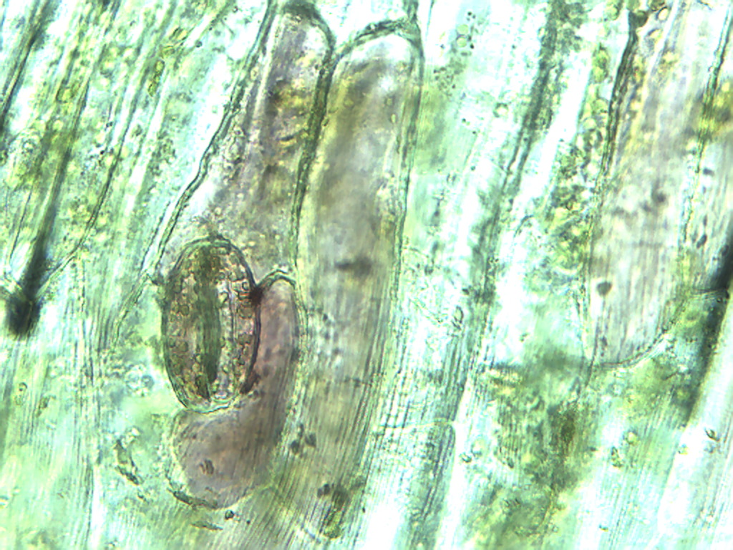
Notes:
434. Rhubarb; Stomate with guard cells (arrows) in epidermis of petiole, 25X.

Slide 7
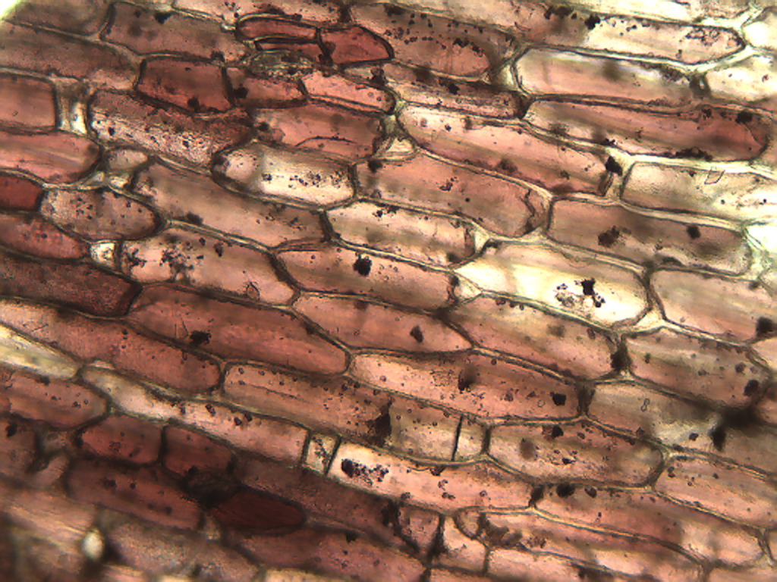
Notes:
35. Rhubarb. Pigmented epidermal cells in petiole, 10X. Note druse crystals (arrows)

Slide 8
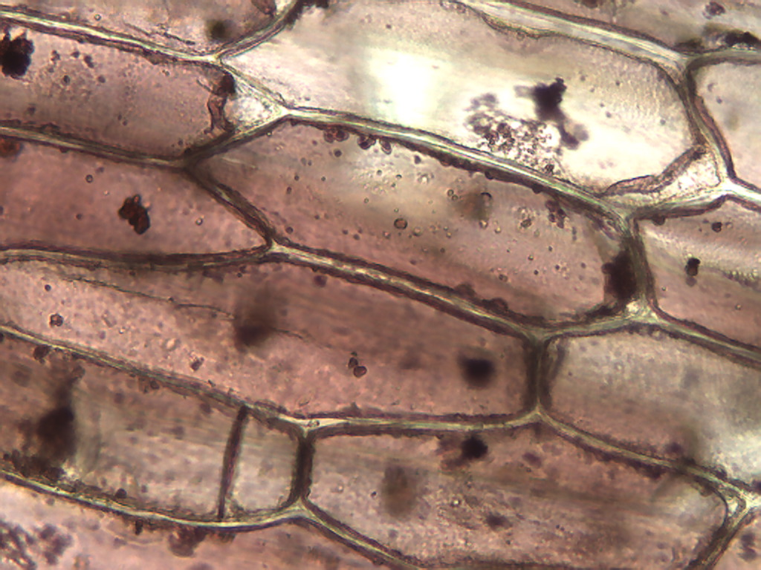
Notes:
436. Rhubarb petiole. Pigmented epidermal cells with druse crytals (arrows), 25X.

Slide 9
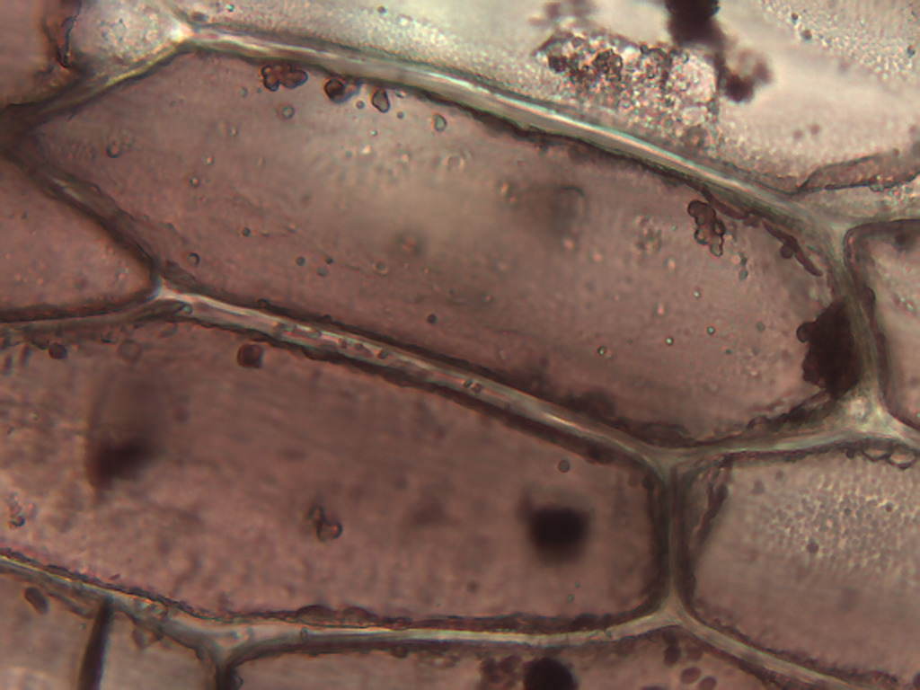
Notes:
437. Rhubarb. Pigmented epidermal cells in petiole, 40X.

Slide 10
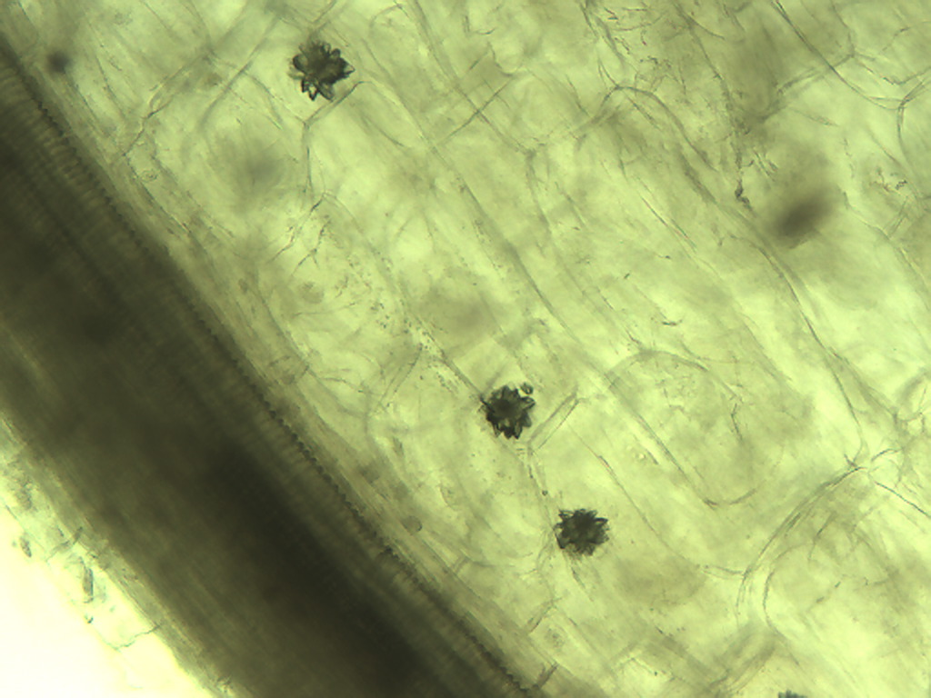
Notes:
438. Rhubarb. Druse crystals in petiole, 10X.

Slide 11
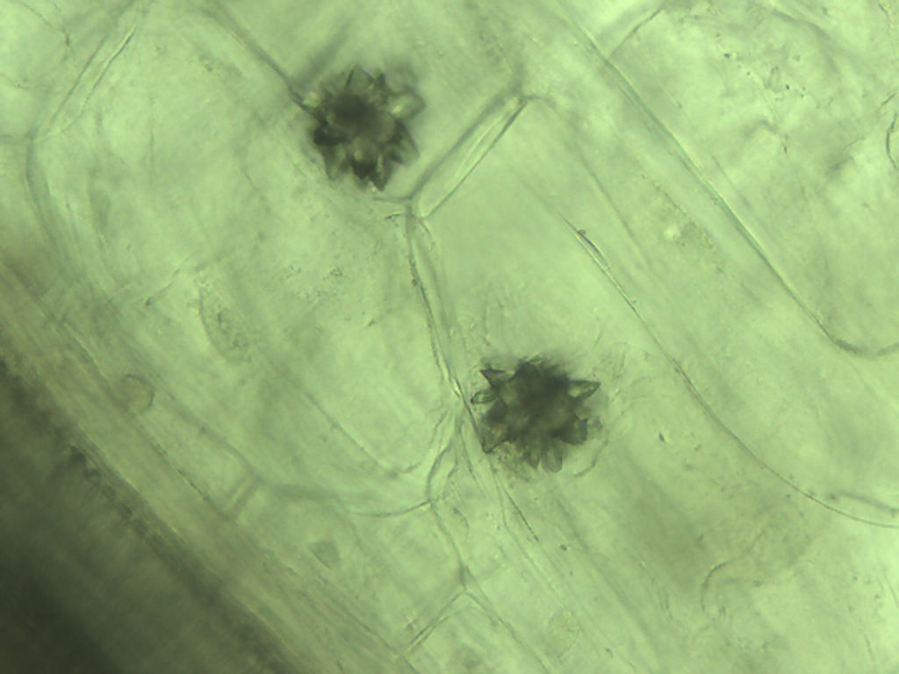
Notes:
439. Rhubarb. Druse crystals in petiole, 25X.

Slide 12
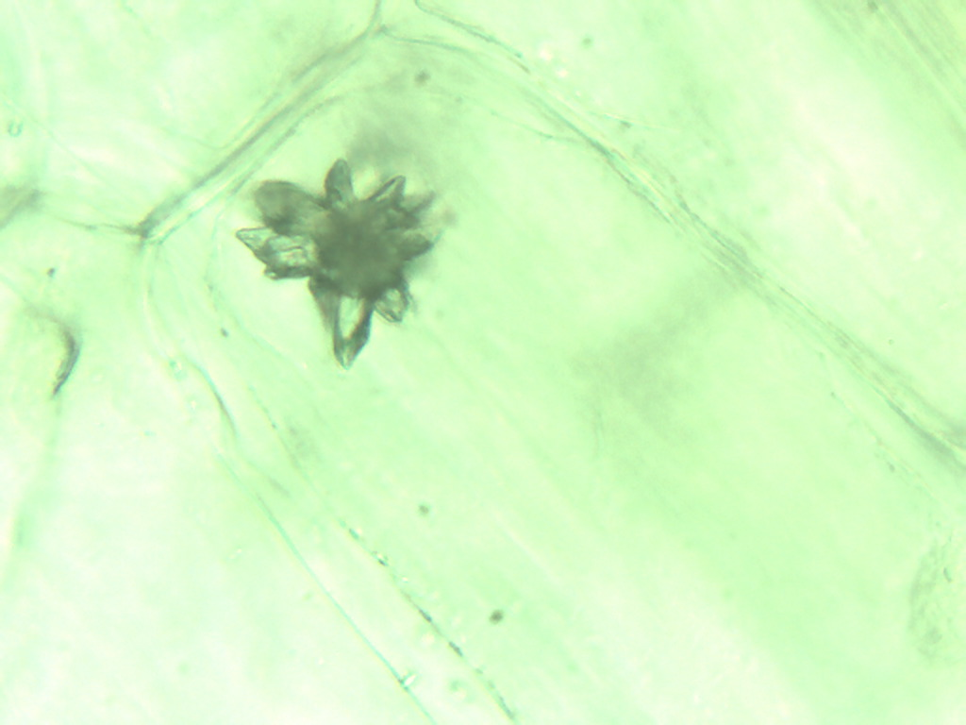
Notes:
440. Rhubarb. Druse crystal in petiole, 40X.

Slide 13
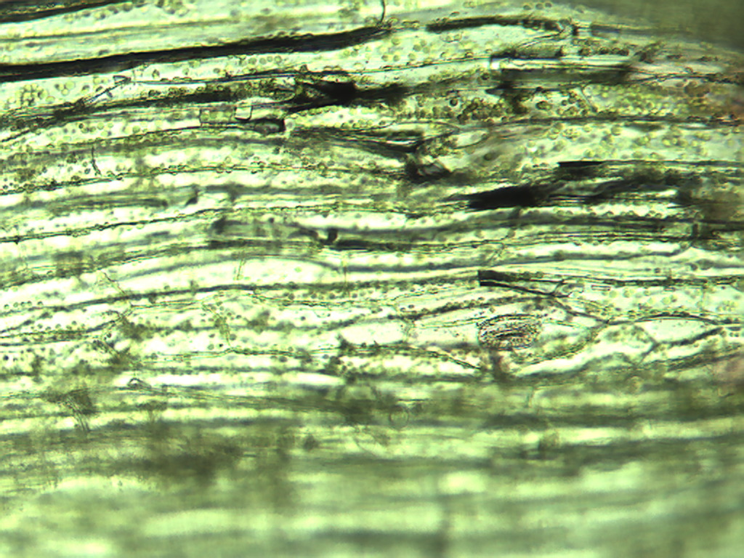
Notes:
441. Rhubarb. Epidermal and photosynthetic cells (arrow) in petiole skin, 10X.

Slide 14
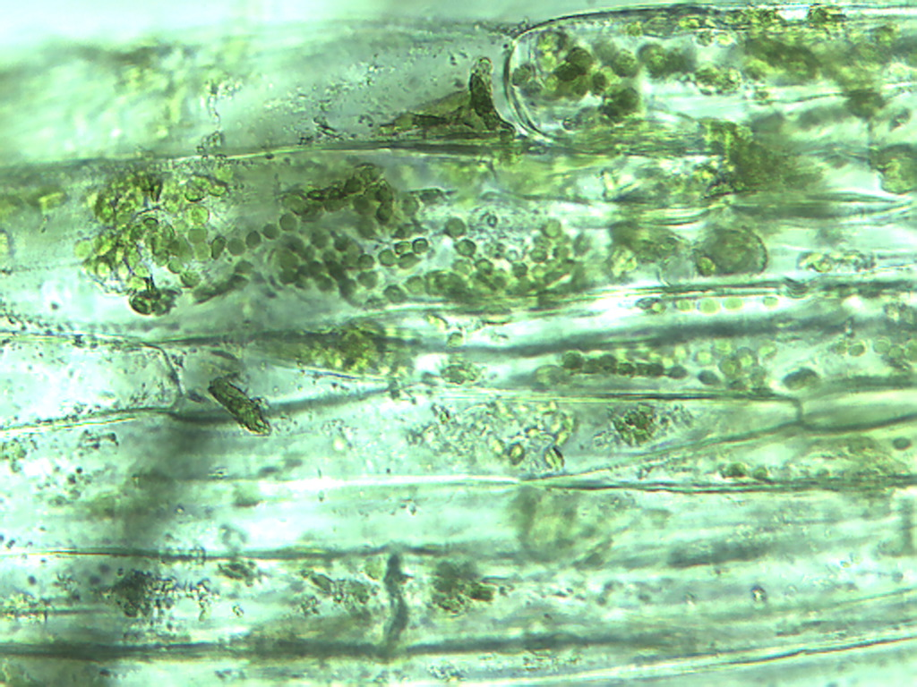
Notes:
442. Rhubarb. Photosynthetic cells in petiole, 25X. Note numerous chloroplasts (arrow).

Slide 15
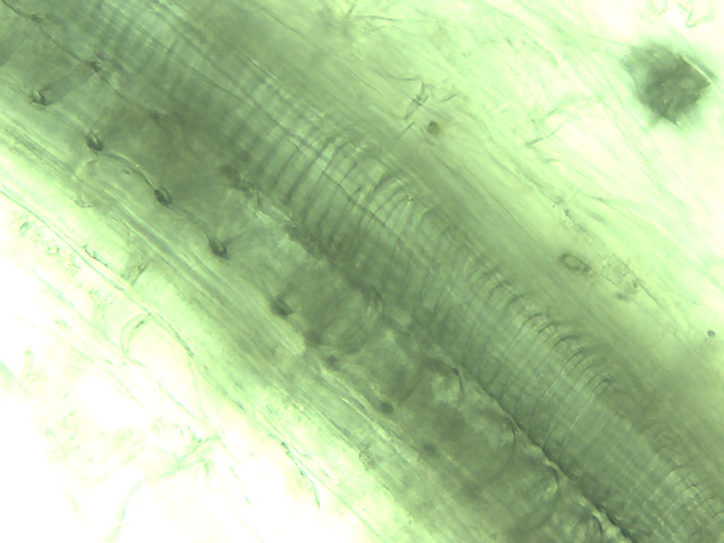
Notes:
443. Rhubarb. Vessels in petiole, 25X.

Slide 16
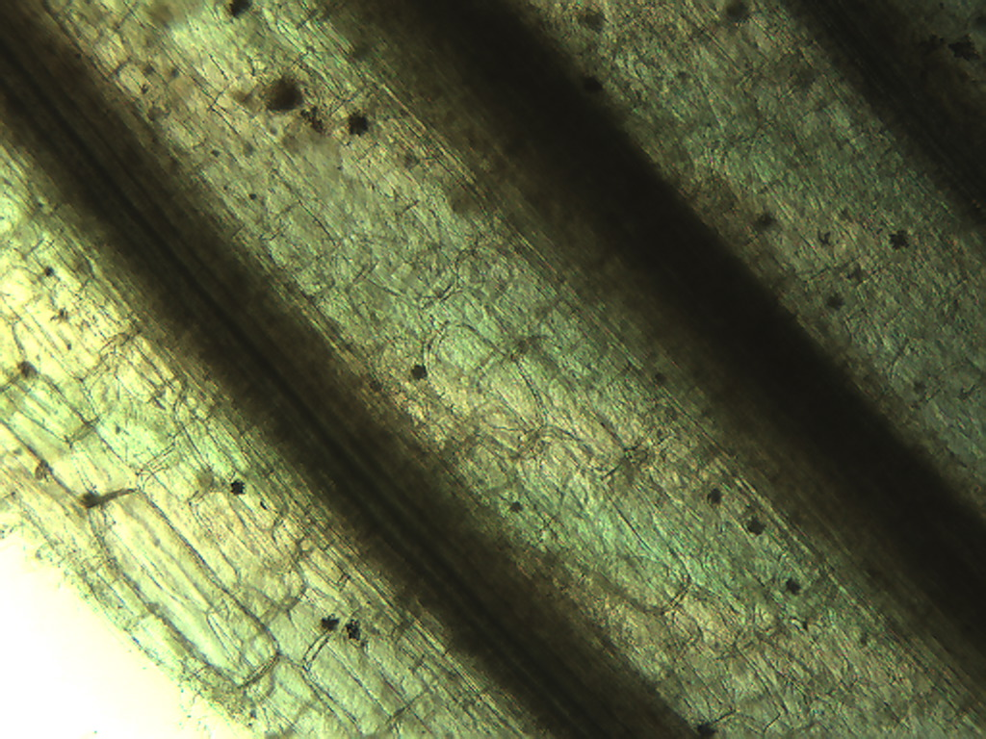
V
V
Notes:
444. Rhubarb. Stalk (petiole) showing druse crystals (black arrows) and bundles of vessels (V), 4X.

Slide 17
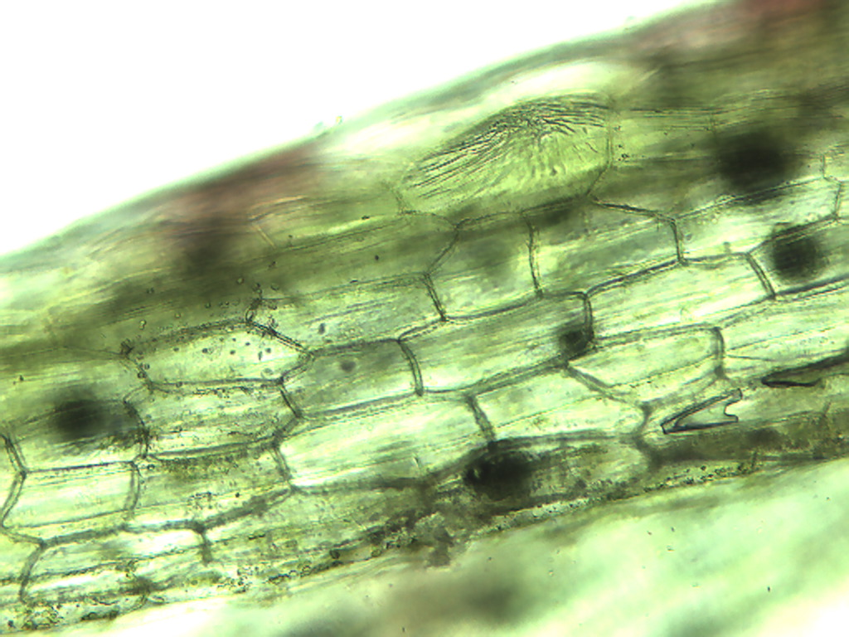
Notes:
445. Rhubarb. Epidermal cells in petiole skin, 10X.

Slide 18
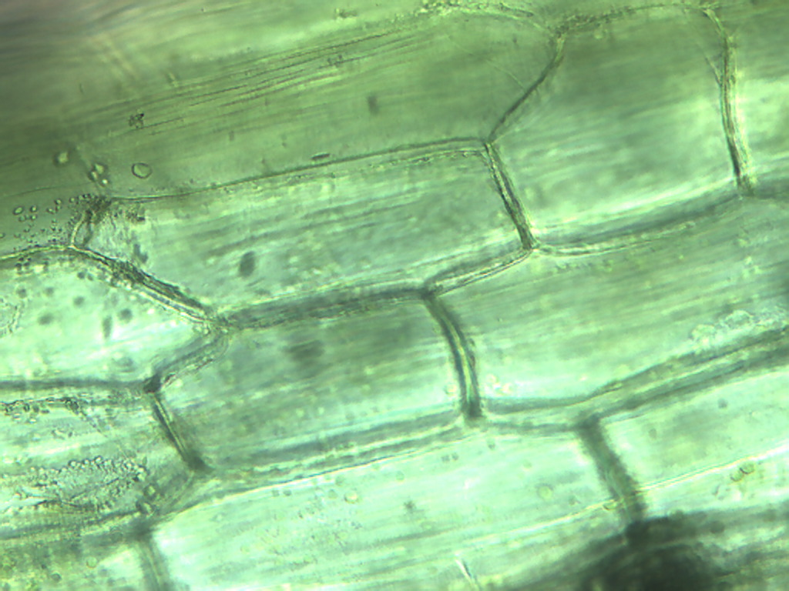
Notes:
446. Rhubarb. Epidermal cells in petiole skin, 25X.

